Slide 1
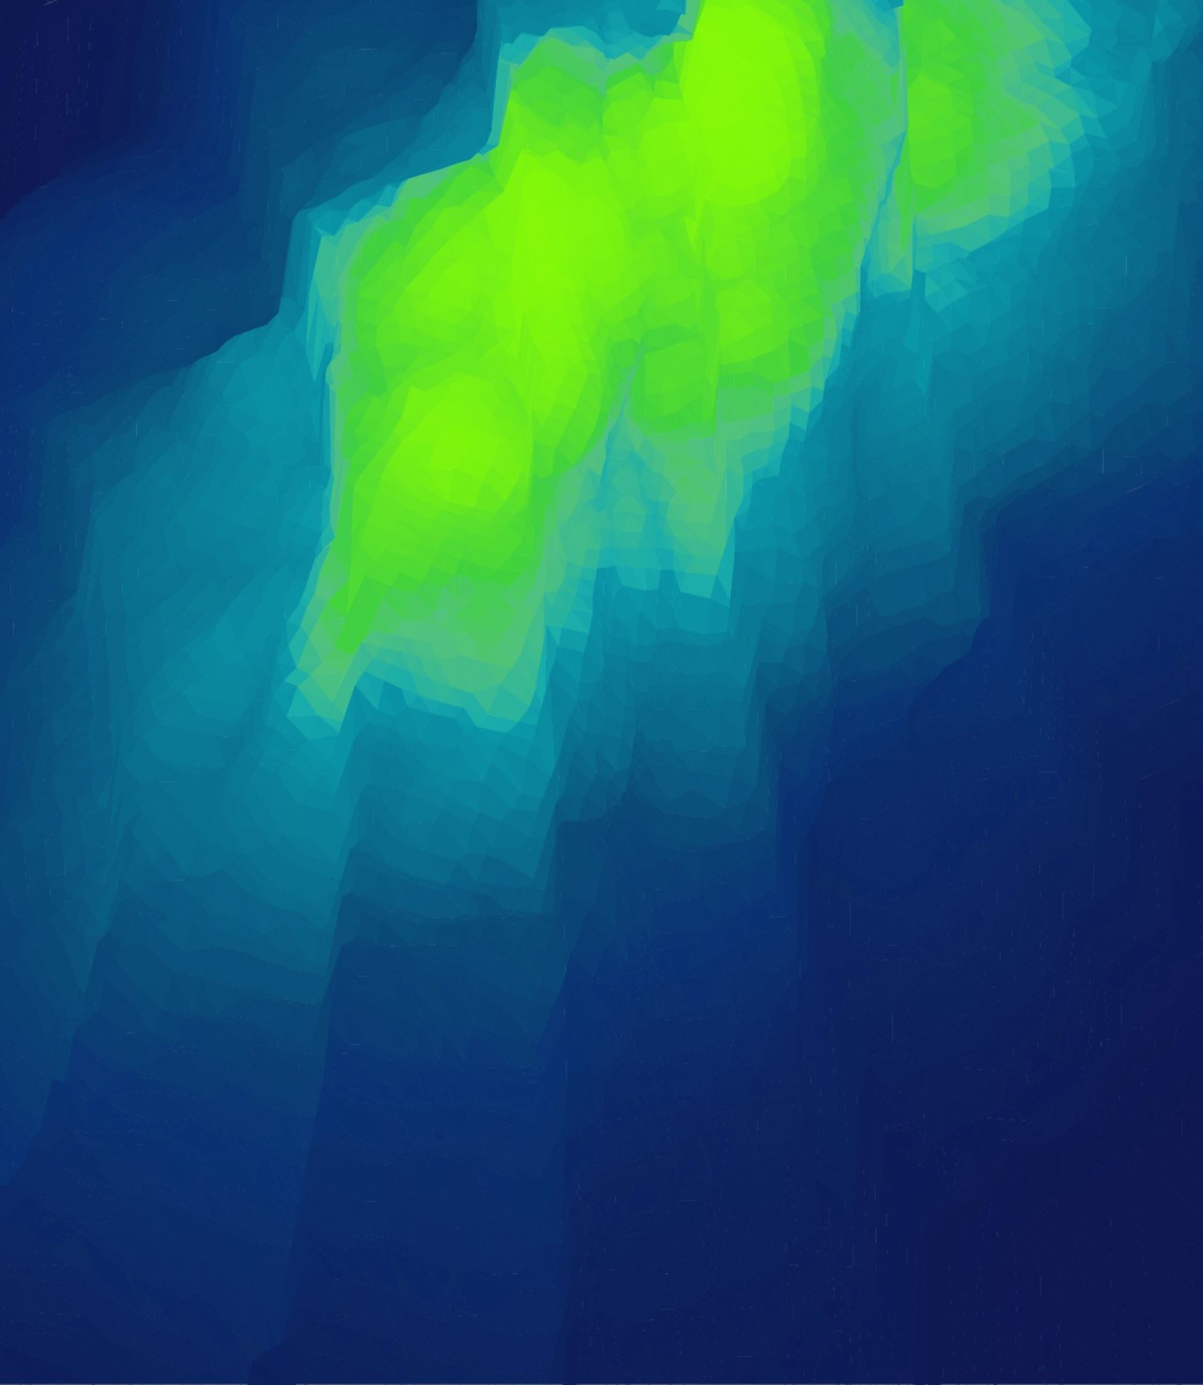

Optimizing Restaurant Service
In Real-Time Using
Deep Reinforcement Learning
Matthew Boraske

Slide 2
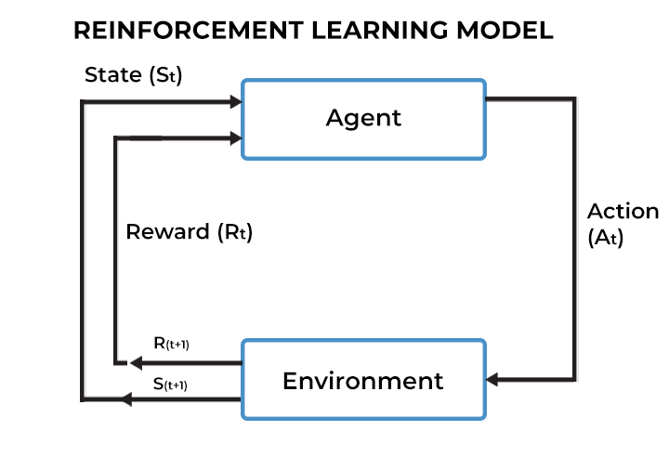
Deep Reinforcement Learning (DRL)
Proximal Policy Optimization Agent Trained on CartPole Environment
Training a machine learning model (agent) to learn the optimal actions for an environment
This is achieved by having the agent take an action given a state and a reward for the previous action taken
The model uses these rewards to progressively learn a policy that selects actions that result in greater rewards
Training involves exploiting what the model has learned about the environment and also exploring new states by taking pseudo-random actions.
Deep Q-Learning (DQN) Agent Trained on LunarLander Environment
In DRL, the trained models use deep neural networks to parameterize the policy

Slide 3
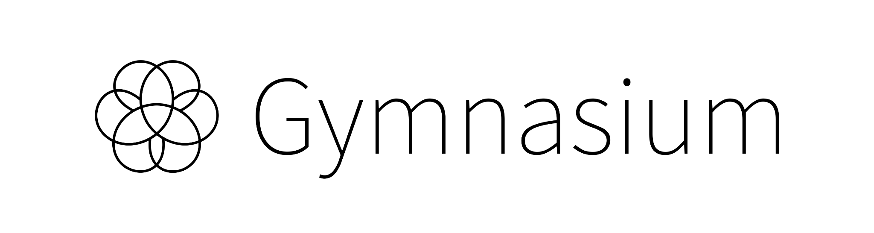

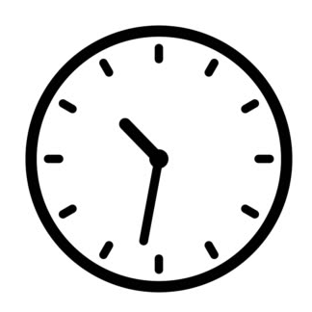
Using DRL to Control a Real-Time Systems (RTS)
Real-time systems (RTS) are a natural candidate for control via agents trained using DRL
Design a reward function that is dependent on time and penalizes the missing of task deadlines.
However, the system must be designed as an environment that the DRL agent can effectively interact with.
The OpenAI Gym project provided a widely adopted interface for reinforcement learning environments, but the creation of custom environments that implement this interface has been left to the open-source community.
Gymnasium, the currently maintained fork of Gym, has not officially recognized any third-party environment for allocating labor in a restaurant-like environment.
This research addresses this gap

Slide 4
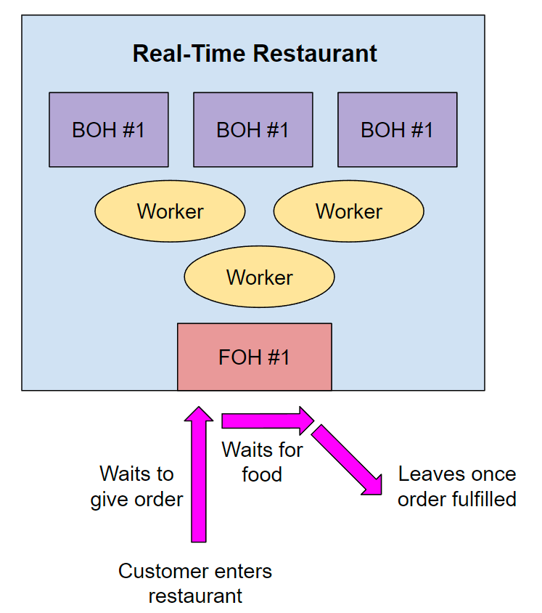
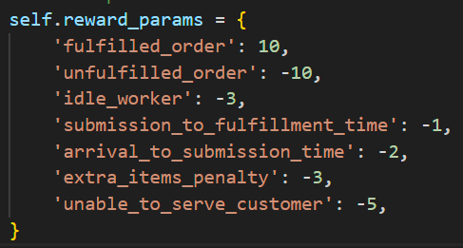
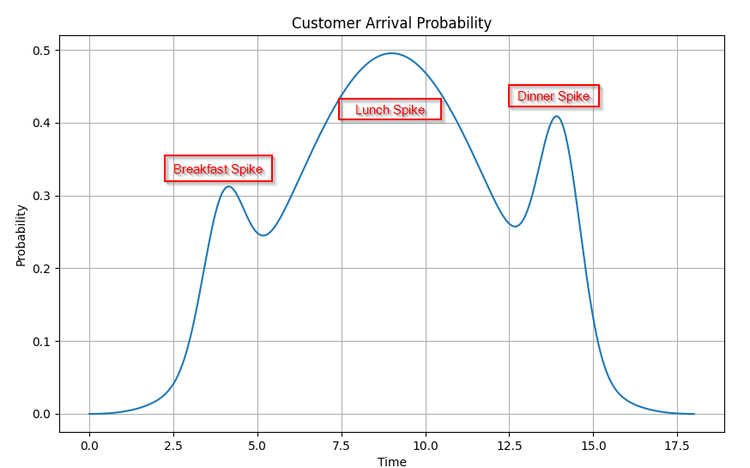
The Restaurant Environment
Workers either…
Take/fulfil orders at Front of House
Create food at Back of House (BOH) stations
Each step in the environment is one minute of an 18-hour period (mimics a restaurant being open from 6AM to 12 AM)
Agent is tasked with allocating workers to minimize customer wait time

Slide 5
Restaurant Environment Parameters
Internal State
Observation Space
Action Space
- current time (0 to 1080 minutes)
- rejected customers
- restaurant capacity
- max new customers per minute
# of tasks
Task
#1
- assigned workers
- amount of this item amongst all orders
- amount of this item in the inventory
- customers waiting to place their order
- customers waiting for their order to be fulfilled
Number of workers to assign to each task
Task Information
Task
#2
Task #1
- assigned workers
- task type
- in-progress inventory
- yield per worker
Task
#2
Task
#3
Task
#1
Task
#2
Task
#3
Task
#4
Task
N
Task
#4
Task
N
Task
#3
# of tasks
Food Inventory
Task
#4
Sum of assignments cannot exceed total amount of workers
Item
#1
Item
#2
Item
#3
Item
N
Customer Orders
Task
N
Order #1
Order #1
Order #1
Order N

Slide 6
A Deeper Look at The Reward Function
If Time != 1080:
Reward(action) =
Orders_Fufilled_Reward + Idle_Worker_Penalty + Rejected_Customer_Penalty
Reward(action) =
Orders_Fufilled_Reward + Idle_Worker_Penalty + Rejected_Customer_Penalty + Extra_Items_Penalty +
Unfulfilled_Orders Penalty
If Time == 1080:

Slide 7
An Example Reward Calculation
Assume the following for the step that corresponds to 8:05 AM
Two orders were completed with the following characteristics:
Order #1: arrived at 8 AM, placed at 8:02 AM, and fulfilled at 8:05 AM
Order #2: arrived at 8:01 AM, placed at 8:01 AM, and fulfilled at 8:05 AM
One customer was rejected due to the restaurant being at capacity
One worker is idle.
Total Reward = Order_1_Reward + Order_2_Reward + Rejected_Customer_Penalty + Idle_Customer_Penalty
time-dependant penalties
Total Reward =
3 + 6 - 5 - 3 = 1
Reward from order #1 = 10 + (2 * -2) + (3 * -1) = 3
Reward from order #2 = 10 + (0 * -2) + (4 * -1) = 6
Rejected_Customer_Penalty = 1 * -5 = -5
Idle_Customer_Penalty = 1 * -3 = -3

Slide 8
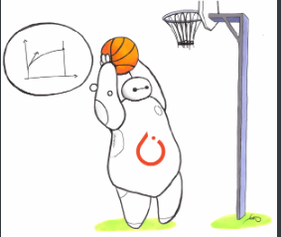
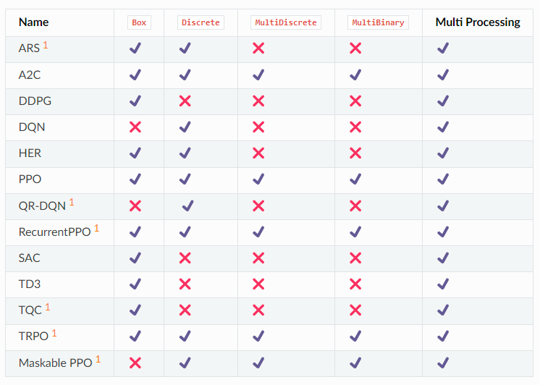
Upcoming Work
Training of DRL models on the custom Restaurant environment using various RL algorithms
Stable-Baselines3 library provides efficient implementations of reinforcement learning algorithms
PPO: Proximal Policy Optimization
Combines ideas from A2C (having multiple workers) and Trust Region Policy Optimization (TROP) as it uses a trust region to improve the actor.
A2C: Advantage Actor Critic
A synchronous, deterministic variant of Asynchronous Advantage Actor Critic (A3C). It uses multiple workers to avoid the use of a replay buffer.
DDPG: Deep Deterministic Policy Gradients
Combines the idea behind Deep Q-Networks (DQN) with a deterministic policy gradient to obtain an algorithm for continuous actions.

Slide 9
Thank you!
Questions?

